Slide 1
EE4007 - Optical Electronics
Lecture 16 – Photodetectors I
© Alan P. Morrison
March 2010

Slide 2
Introduction
Photodetector - absorbs optical energy and converts it to electrical energy, usually manifested as a photocurrent
3 steps in detection process
  absorption of optical energy and generation of carriers
  transportation of photogenerated carriers across absorption and/or transit region, with or without gain
  carrier collection and generation of a photocurrent
Used to detect optical signals over wide range of wavelengths
Performance requirements are:
  high sensitivity, low noise, wide bandwidth, high reliability and low cost
  bandwidth and gain are typical trade-offs - usually decided by application
© Alan P. Morrison
March 2010

Slide 3
Introduction
Different detector types:
  photoconductors, p-i-n diodes, avalanche photodiodes, MSM, Resonant Cavity Enhanced (RCE), PMT, GM-APD, phototransistors, CCD, Solar Cells, Micro-channel plates (MCP).
Absorption processes follow examples discussed previously
External Quantum Efficiency, η, of a photodetector is given by
The internal quantum efficiency is the number of carrier pairs produced per incident photons absorbed and is usually very high ~ 1 for defect free materials
© Alan P. Morrison
March 2010

Slide 4
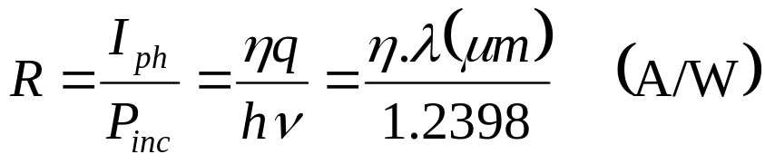
Introduction
External quantum efficiency depends on the absorption coefficient of the material and the thickness of the absorbing region
Responsivity, R, defined as:
For fixed η, R should increase linearly with λ
  in reality the quantum efficiency is dependent on the absorption coefficient, which itself depends on the incident wavelength
© Alan P. Morrison
March 2010

Slide 5
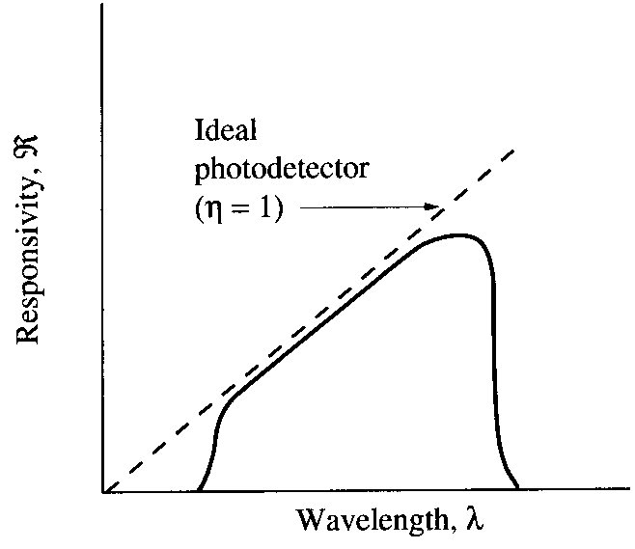
Introduction
Long wavelength cut-off of spectral response, due to absorption edge, or bandgap of semiconductor
Short wavelength cut-off is due to all optical energy being absorbed near the surface, because of the large value of the absorption coefficient
Schematic illustration of responsivity of real and ideal photodetectors:
© Alan P. Morrison
March 2010

Slide 6
Junction Photodiodes
Photodiodes useful for the spectral range from visible to far infra-red can be made from elemental and compound semiconductors
Diode is operated under reverse bias conditions, the depletion layer is quite wide and only a small dark (leakage) current flows through the device
Photoexcitation => photons absorbed to create e-h pairs
e-h pairs are accelerated in opposite directions across the depletion region, by the built-in electric field, giving rise to a photocurrent.
Magnitude of the photocurrent depends on quantum efficiency
Only carriers produced in the depletion region, or within a diffusion length of it, contribute to the photocurrent
© Alan P. Morrison
March 2010

Slide 7
Junction Photodiodes
Increased reverse bias current proportional to incident light intensity
Desirable to have large depletion width, so more useful photons can be absorbed
  downside to this is increased transit time across the depletion region, which degrades the high speed performance of the device
  in practical devices, a compromise is made between the responsivity of the diode(proportional to photocurrent produced), and the bandwidth, which is related to the transit time across the depletion region, the junction capacitance and the resistance of the diode in the circuit
  to achieve higher levels of photocurrent, or to detect low light levels, it is customary to use avalanche photodiodes, which provide internal gain mechanism
© Alan P. Morrison
March 2010

Slide 8
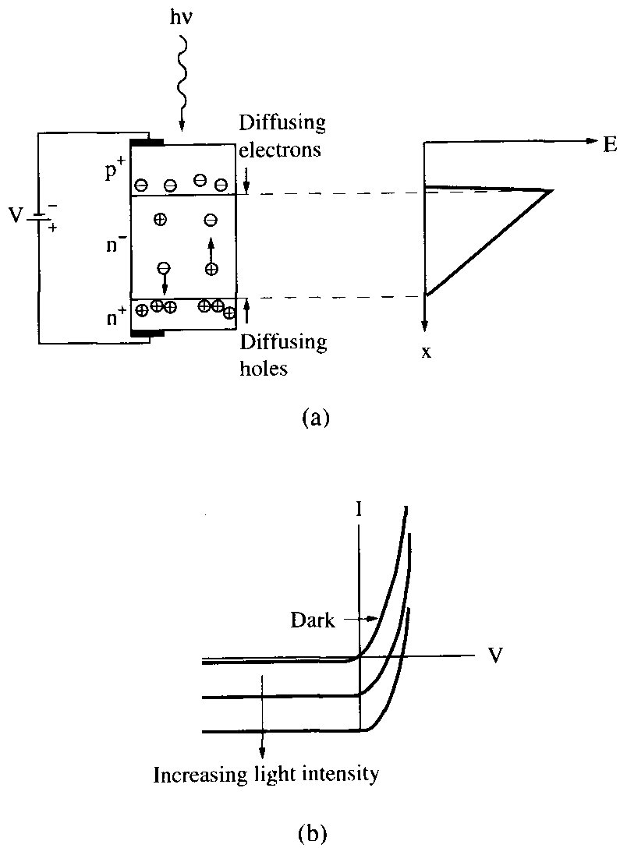
Junction Photodiodes
© Alan P. Morrison
March 2010

Slide 9
p-i-n Photodiodes
Intrinsic region sandwiched between p⁺ and n⁺ regions
most of applied bias is dropped across the highly resistive intrinsic region
Increasing width of depletion region => improved internal quantum efficiency, but increased transit time
trade-off between quantum efficiency and speed
p-i-n diode has no internal gain => gain-bandwidth product = bandwidth
diffusion of carriers outside i-layer can lower response speed
  minimise by making junction close to illuminated surface
reduce device capacitance by making area smaller
© Alan P. Morrison
March 2010

Slide 10
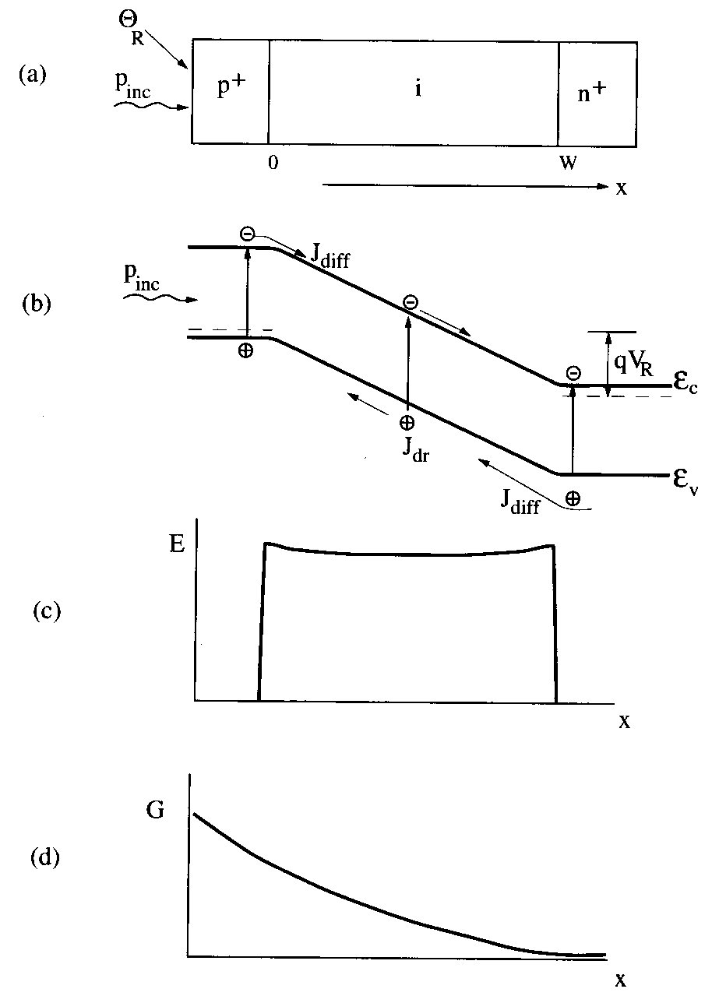
p-i-n Photodiodes
Optimal design usually means transit time = RC time constant
© Alan P. Morrison
March 2010

Slide 11
Quantum efficiency and frequency response
Carriers produced within the depletion region or within a diffusion length of it will be separated by the electric field and will lead to current flow in the external circuit.
External quantum efficiency is given by:
necessary conditions for high quantum efficiency are: good AR coating, and αW >> 1 to make sure all photons are absorbed
preferable to keep W small and have α large => ensures faster device
© Alan P. Morrison
March 2010

Slide 12
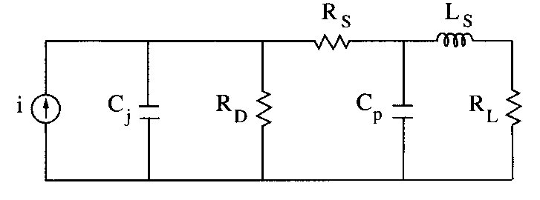
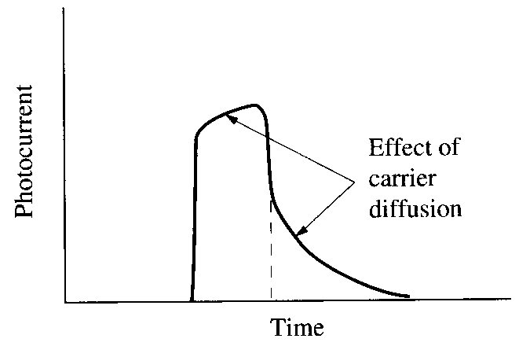
Quantum efficiency and frequency response
Equivalent circuit:
R_{D}=shunt (junction) resistance ~100MΩ
R_{S}=series (contact+undepleted diode) resistance ~10Ω
R_{L}=load resistance = 50Ω
C_{j}=junction cap. _~ fF
C_{p}=parasitic cap. ~fF
The 3dB bandwidth is usually expressed as 1/(2FWHM) of the impulse response
diffusion adds a “slow-tail” to impulse response
© Alan P. Morrison
March 2010

